Slide 1
THE OSTHE OOSI security architectureTY ARCHITECTUREI SECURITY ARCHITECTURETHE OSI SECURITY ARCHITECTURE
The OSI security architecture is useful to managers as a way of organizing the task of providing security.
The OSI security architecture focuses on security attacks, mechanisms, and services.
■ Security attack: Any action that compromises the security of information owned by an organization.
■ Security mechanism: A process (or a device incorporating such a process) that is designed to detect, prevent, or recover from a security attack.
■ Security service: A processing or communication service that enhances the security of the data processing systems and the information transfers of an organization. The services are intended to counter security attacks, and they make use of one or more security mechanisms to provide the service.

Slide 2
Threat
A potential for violation of security, which exists when there is a circumstance, capability, action, or event that could breach security and cause harm. That is, a threat is a possible danger that might exploit a vulnerability.
Attack
An assault on system security that derives from an intelligent threat; that is, an intelligent act that is a deliberate attempt (especially in the sense of a method or technique) to evade security services and violate the security policy of a system.

Slide 3
Introduction to Security

Slide 4
Confidentiality: Preserving authorized restrictions on information access and disclosure, including means for protecting personal privacy and proprietary information.
»­Not only applies to the storage of information. It also applies to the transmission of information
Integrity:
Availability
»The information created and stored by an organization needs to be available to authorized entities
»Information is useless if it is not available.

Slide 11
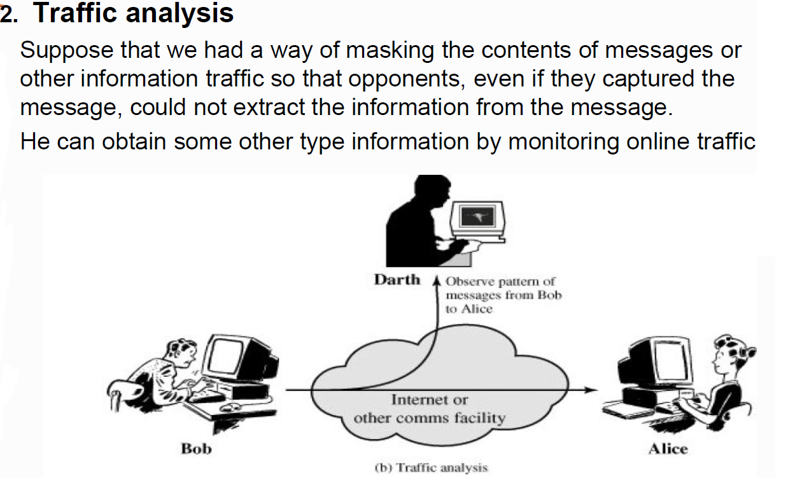

Slide 13
/ Spoofing
Sometimes the attacker pretends instead to be the receiver entity

Slide 14
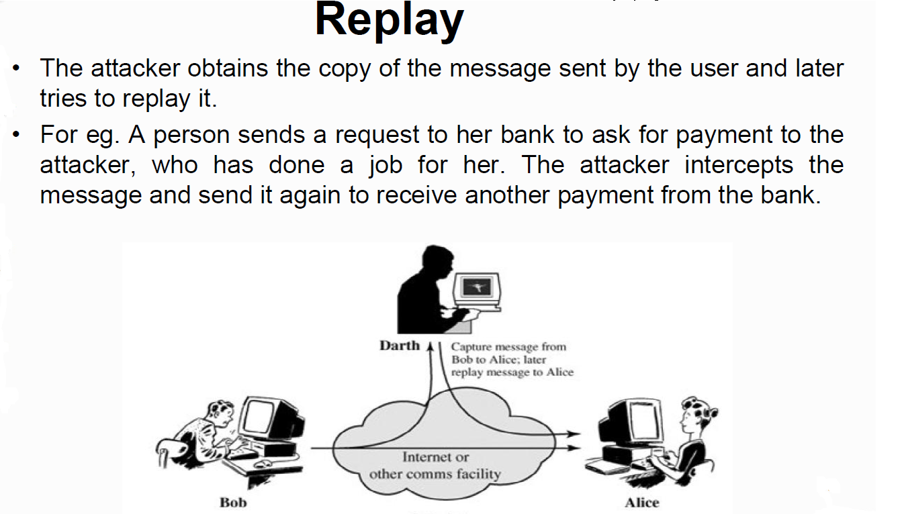

Slide 16
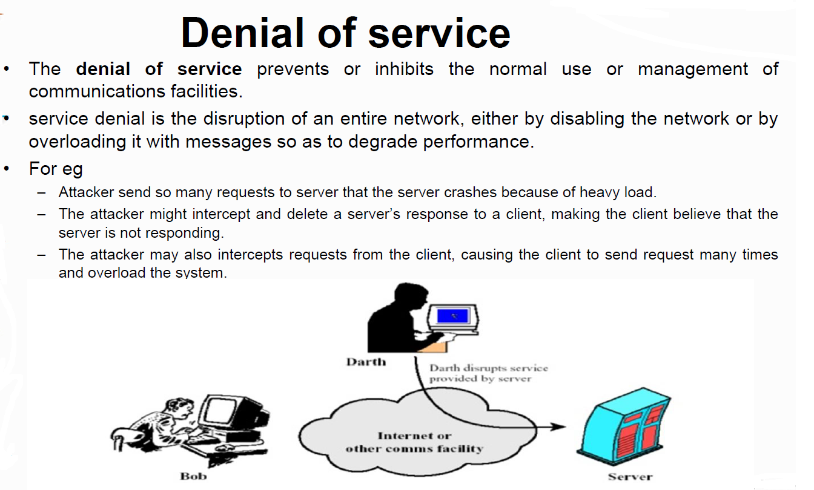

Slide 18
Passive Attacks | Active Attacks
The attacker’s goal is just to obtain information
The attack does not modify the data or harm the system. The system continues with its normal operation | Active attack may change the data or harm the system
Attack may harm the sender or receiver of the message
Difficult to detect passive attack | Easier to detect
Prevented by encipherment of data
Attacks that threaten confidentiality are passive | Attacks that threaten the integrity and availability are active

Slide 19
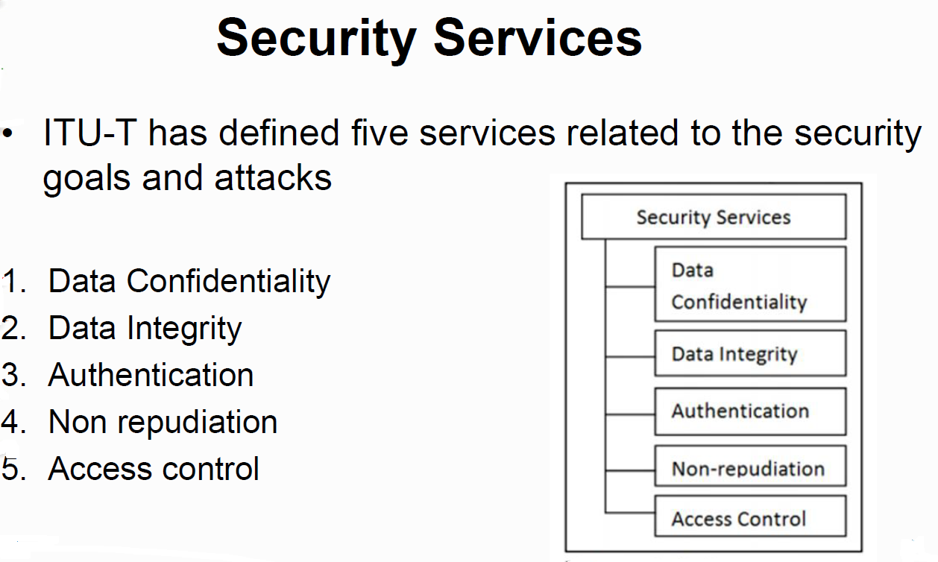

Slide 20
Data confidentiality
Protection of transmitted data from passive attacks
Designed to prevent snooping and traffic analysis attack
This requires that an attacker not be able to observe the source and destination, frequency, length, or other characteristics of the traffic on a communications facility.

Slide 21
Data Integrity
Designed to protect data from modification, insertion, deletion and replaying by an adversary
Protect the whole message or part of the message.
Connection-oriented integrity service: Deals with a stream of messages, assures that messages are received as sent with no duplication, insertion, modification, reordering, or replays. The destruction of data is also covered under this service.
Connectionless integrity service: Generally provides protection against message modification only

Slide 23
Non Repudiation
Protects against repudiation by either the sender or the receiver of the data.
Non repudiation with proof of the origin: The receiver of the data can later prove the identity of the sender if denied.
Non repudiation with proof delivery: The sender of the data can later prove that the data were delivered to the intended recipient.

Slide 24
Access control
Provides protection against unauthorized access to data
The term access involves reading, writing, modifying, executing programs and so on.

Slide 25
Security Mechanisms
ITU-T(X.800) recommends some security mechanisms to provide security services

Slide 26
Specific Security Mechanisms

Slide 27
  Encipherment: Hiding or covering data provide confidentiality.
  The use of mathematical algorithms to transform data into a form that is not readily intelligible.
  The transformation and subsequent recovery of the data depend on an algorithm and zero or more encryption keys.
  Enciphering Techniques: Cryptography and Steganography
Data Integrity:

Slide 28
Digital Signature
The sender can electronically sign the data and the receiver can electronically verify the signature
Data appended to, or a cryptographic transformation of, a data unit that allows a recipient of the data unit to prove the source and integrity of the data unit and protect against forgery
Authentication Exchange
Two entities exchange some messages to prove their identities to eachother.
Traffic Padding
The insertion of bits into gaps in a data stream to frustrate traffic analysis attempts.

Slide 29
Routing Control
Enables selection of particular physically secure routes for certain data and allows routing changes, especially when a breach of security is suspected.
Notarization
Access Control

Slide 30
PERVASIVE SECURITY MECHANISMS
Mechanisms that are not specific to any particular OSI security service or protocol layer.
Trusted Functionality That which is perceived to be correct with respect to some criteria (e.g., as established by a security policy).
Security Label The marking bound to a resource (which may be a data unit) that names or designates the security attributes of that resource.
Event Detection Detection of security-relevant events.
Security Audit Trail Data collected and potentially used to facilitate a security audit, which is an independent review and examination of system records and activities.
Security Recovery Deals with requests from mechanisms, such as event handling and management functions, and takes recovery actions.

